Slide 1
Session 3:
Breaking Down a Specification
The proposed process of turning a specification into format building blocks.

Slide 2
Overview
Describing the method
Group walkthrough of TIFF v6.0
Example of extending TIFF v6.0 to include “Baseline profiles”
Exercise: Adding to the TIFF space – TIFF v4.0

Slide 3
Things we're not covering
How the sources model has been planned
  POF built, and tested
  4 different sources (PRONOM [format], TriD, Unix[File], and Filesig)
Early work on the datamodel / data dict
  Needed to explore the usecases
  Too early to bake the logical parts
  Model is still conceptual and evolving

Slide 4
The Method…?
Minimise any interpretation of information
Label “things” as they are found in the docs
Use structure from the docs as the guide
Start with the largest object (the spec)
“Atomize” objects as is meaningful

Slide 5
Meaningful?
How many different TIFF formats are there?

Slide 6
Meaningful?
Describe the “Trivial Pursuit Pieces”.

Slide 7

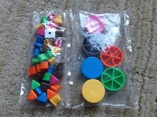



What are you
trying to describe?

Slide 8

Notes:
Lord of the rings tri

Slide 9

Notes:
1.1 The Fellowship of the Ring
1.2 The Two Towers
1.3 The Return of the King

Slide 10
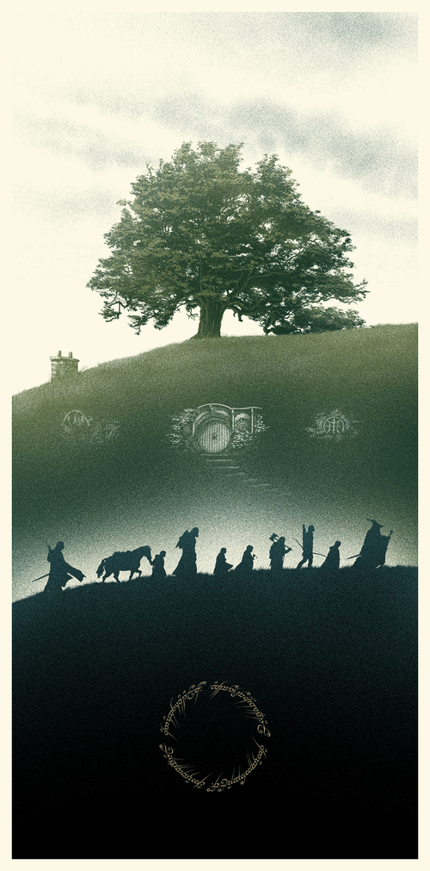
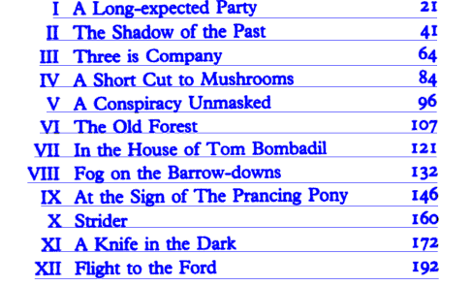
Notes:
The Fellowship of the Ring

Slide 11
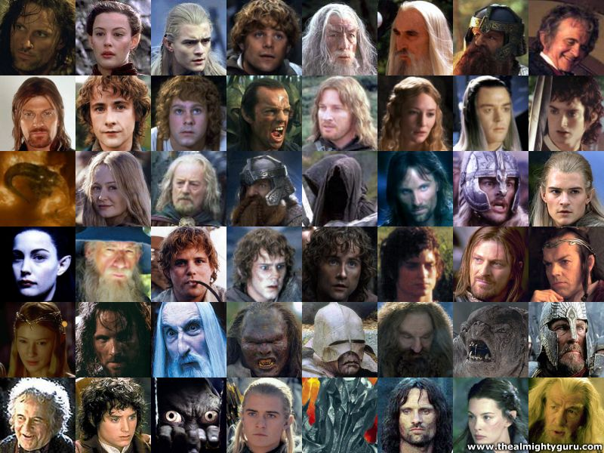
Notes:
There are interleaved characters. Each appearing in dfferent places

Slide 12
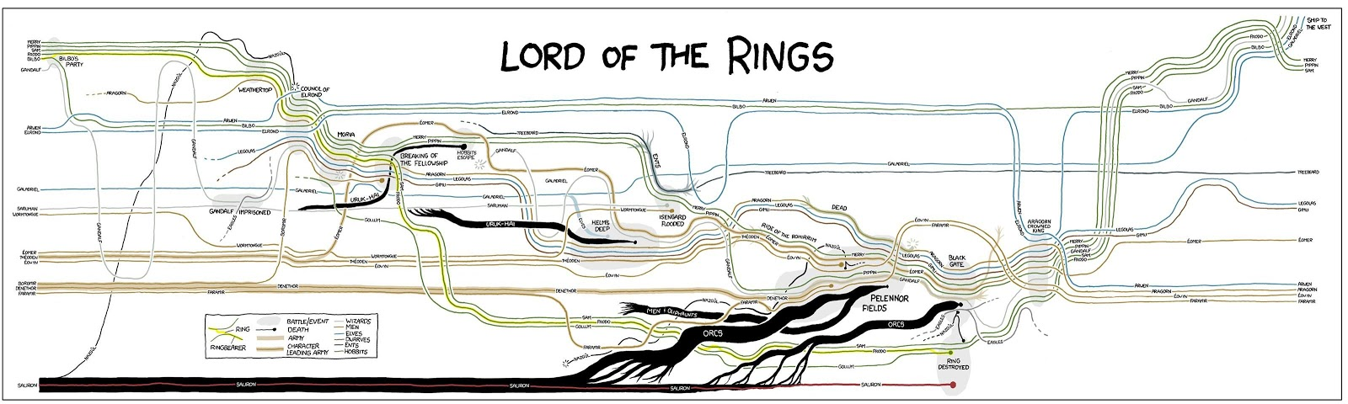
Notes:
We can plot the story through interactions between these characters.

Slide 13
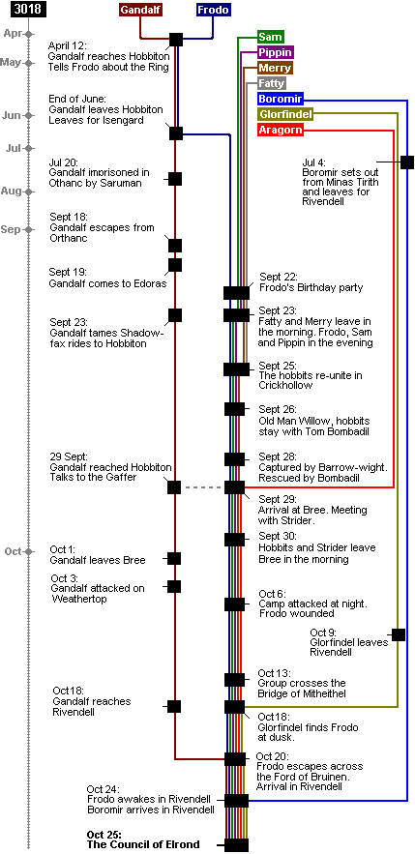
Notes:
We can plot the story through chronological lens?
These are different views of the same intellectual concept, neither are incorrect (assuming the accuracy of the translation) and all (books, timeline, character map, and others are useful to different audiances

Slide 14

And in the format space?
<format_A>
<specification/>
</format_A>

Slide 15
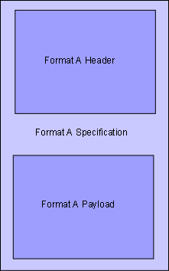
<format_A>
<specification>
<header/>
<payload/>
</specification>
</format_A>

Slide 16
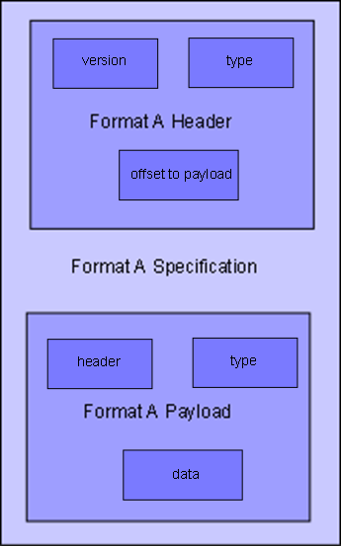
<format_A>
<specification>
<header>
<version/>
<type/>
<offset_to_payload/>
</header>
<payload>
<header/>
<type/>
<data/>
</payload>
</specification>
</format_A>

Slide 17
<format_A>
<specification>
<header>
<version>1.1.2</version>
<type>newsubtype</type>
<offset_to_payload>23ff01</offset_to_payload>
</header>
<payload>
<header/>
<type>3</type>
<data>50 4b … 00 66 60</data>
</payload>
</specification>
</format_A>

Slide 18
What’s the end game?
Outcomes
  Turn a specification / documentation into reusable and reference-able “atoms” of information
    Atoms that have properties or contain other atoms
  You stop describing when you’ve got to the level of detail you need
    Someone else can always come back later and extend your work.

Slide 19
Starting assumptions
There is a beautiful / useful UX layer for doing this work
There is a suitable data model under the UX that can hold this information
There is always a starting place (i.e. we’re starting from known location, like a named format, or a specific specification / standard / RFC etc.)

Slide 20
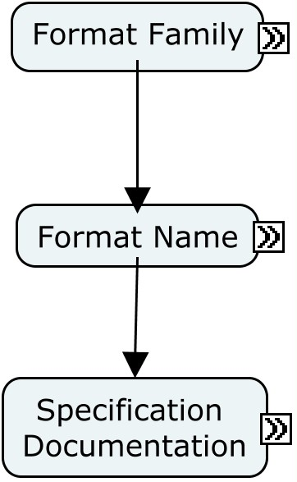
Step 1 – the text itself
The simplest aspect to create is the text itself. Lets conceptualise it like this:-

Slide 21
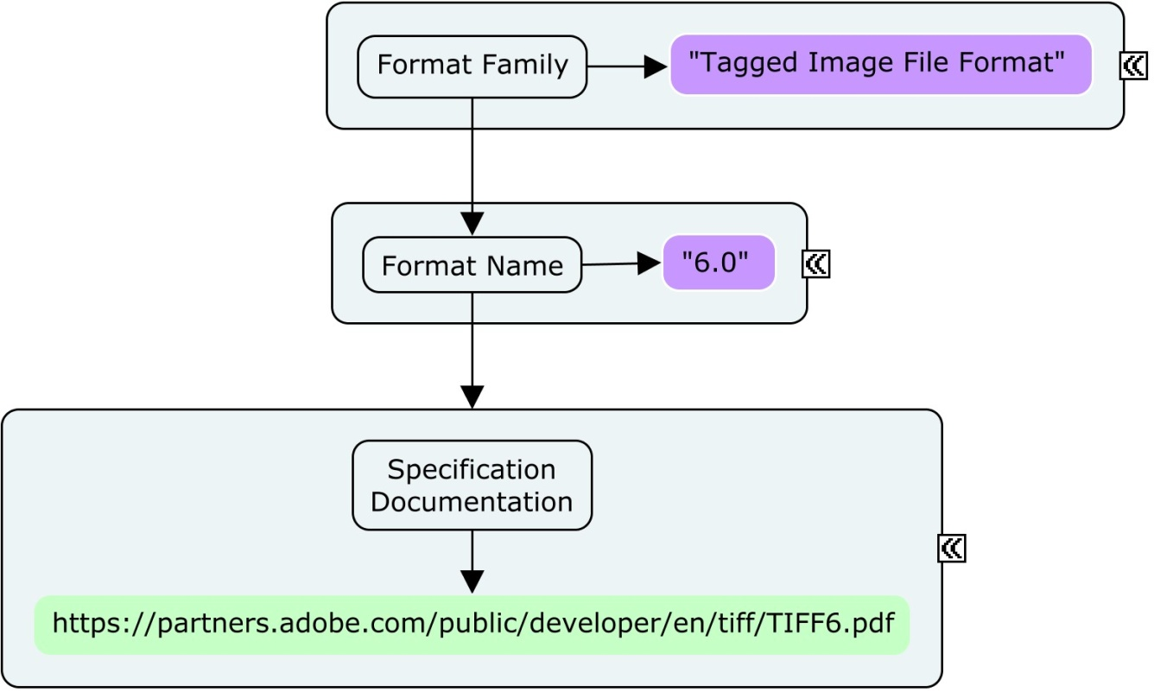
Step 1 – the text itself
And then populate it:-

Slide 22
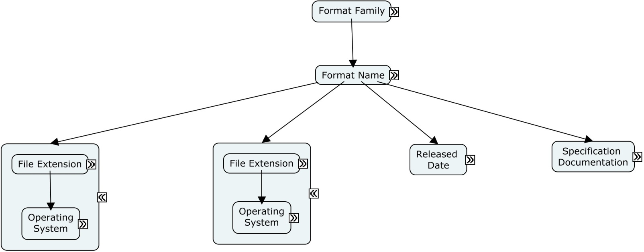
Step 1 – the text itself
Notes:
Of course, there is some attendant information that we know from our other data sources. Lets join these up:-

Slide 23
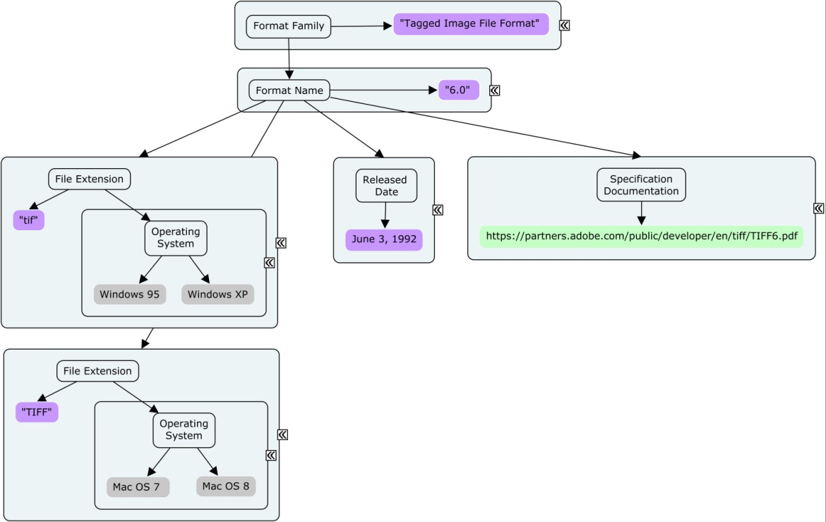
Step 1 – the text itself

Slide 24
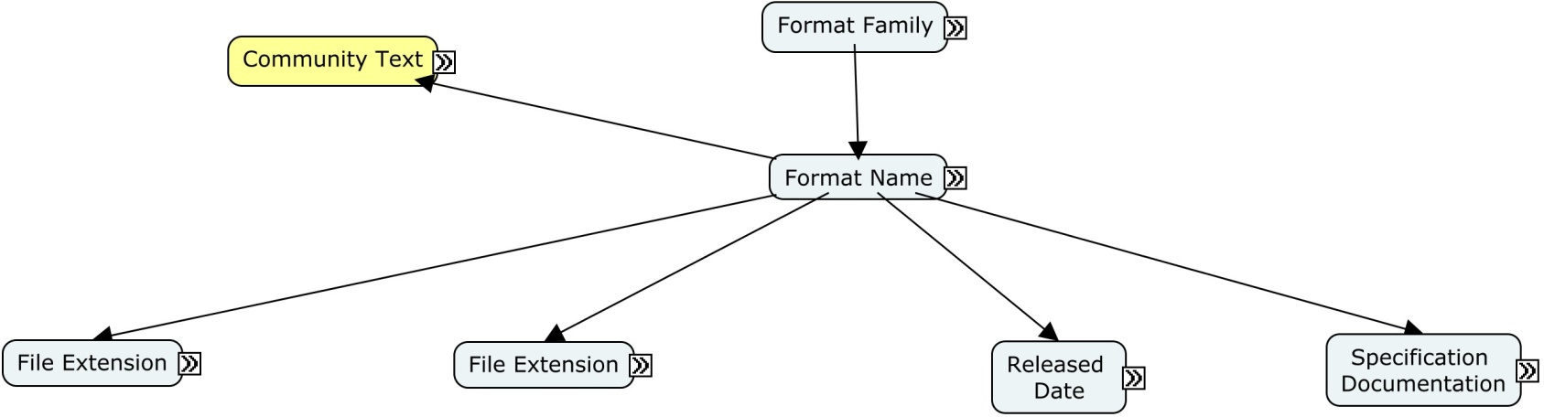
Step 1 – the text itself
Lets add some other general information in the guise of a Community Text object:-

Slide 25
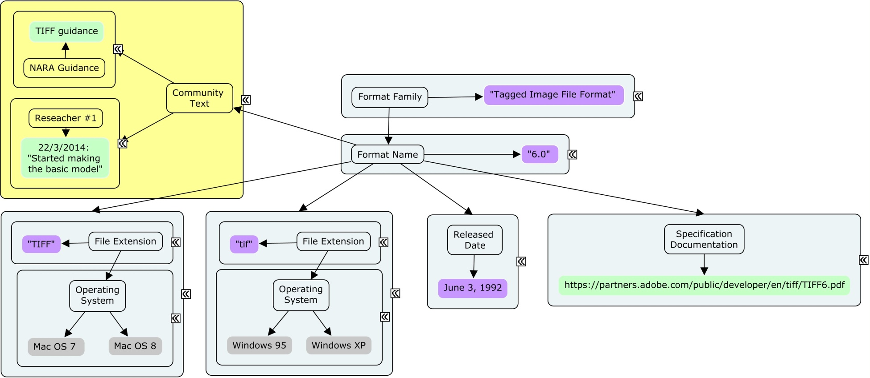
Step 1 – the text itself

Slide 26
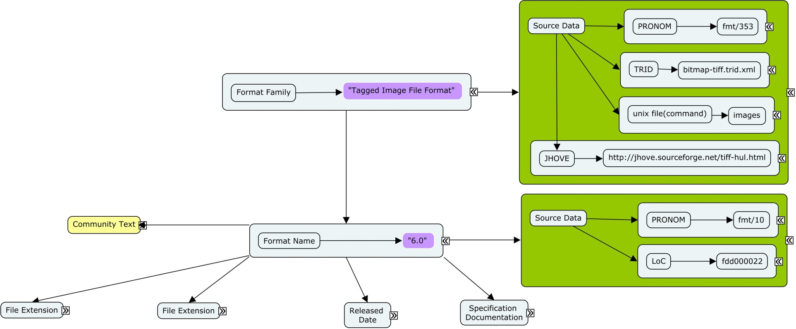
Step 1 – the text itself
Lets add some source data to the basic model, noting that we want to reference on two levels:-

Slide 27
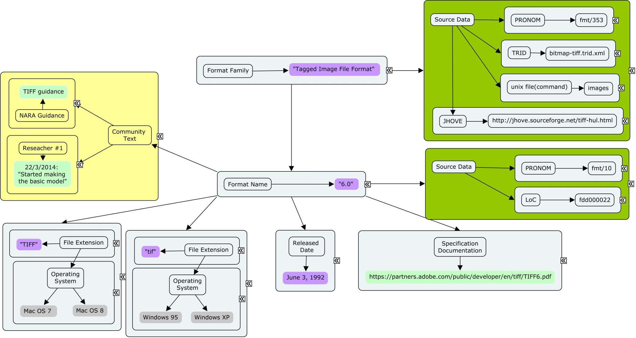
The Most Basic Object

Slide 28
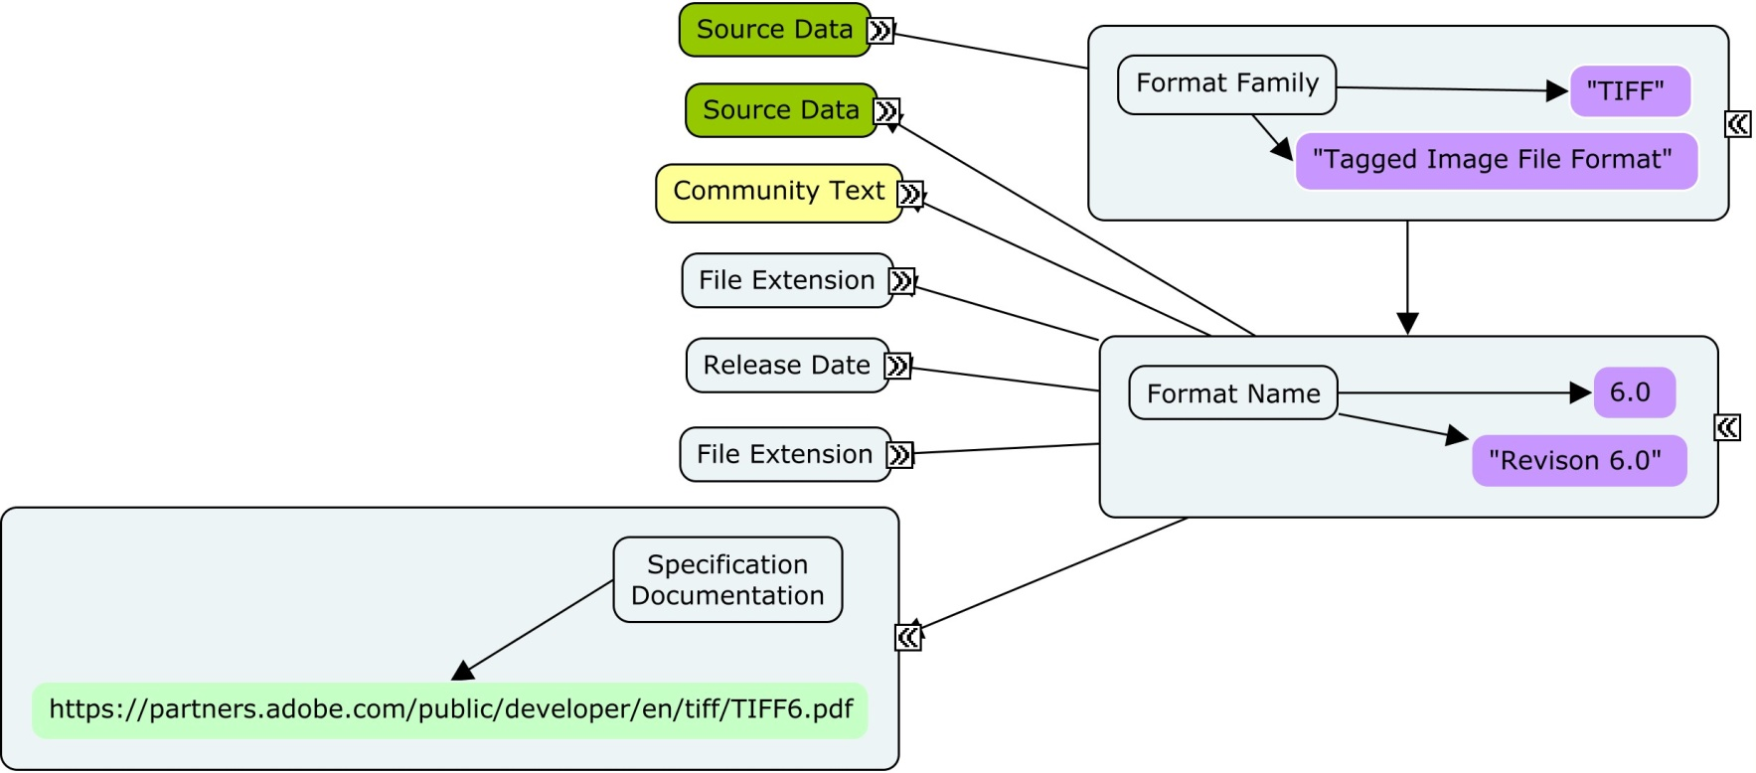
Step 2 – unpacking?
Using the text of the specification as the guide, lets figure out something we want to unpack in our new format object model:-

Slide 29
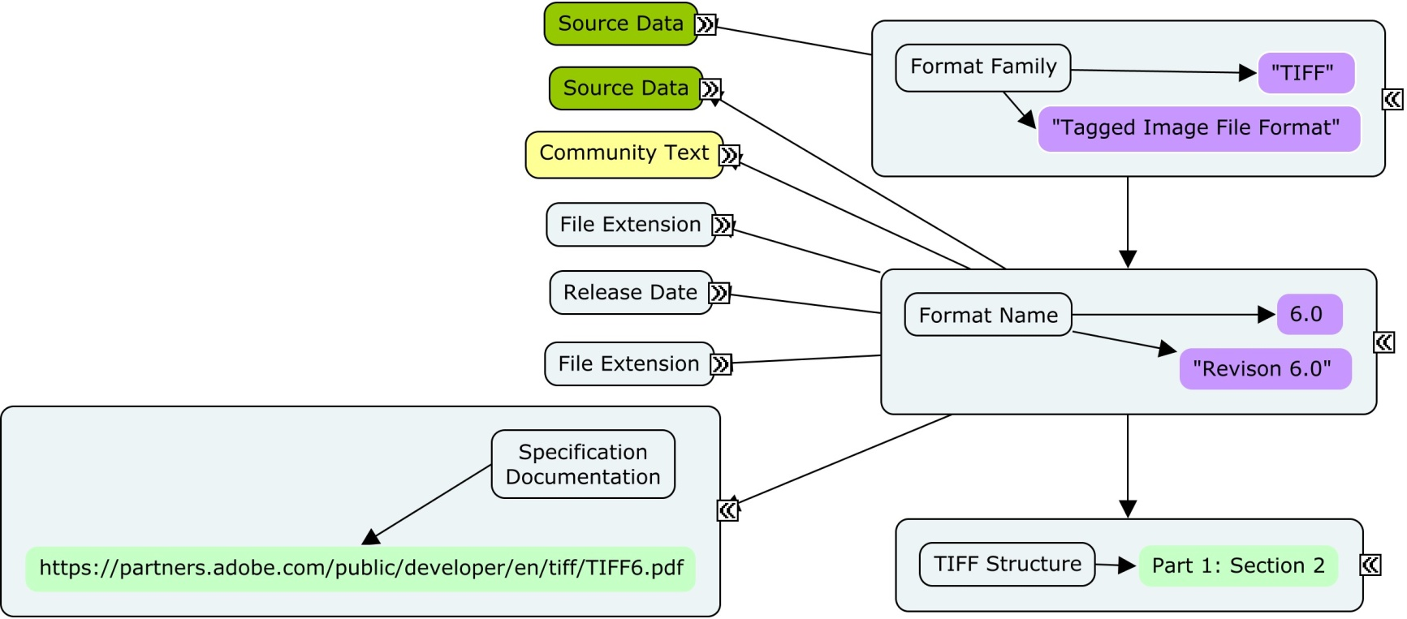
Step 2 – unpacking

Slide 30
Step 2 – unpacking
We can go further, there are more elements we can intellectually liberate in “Tiff Structure”
Looking at the 6.0 spec, what comes next?

Slide 31
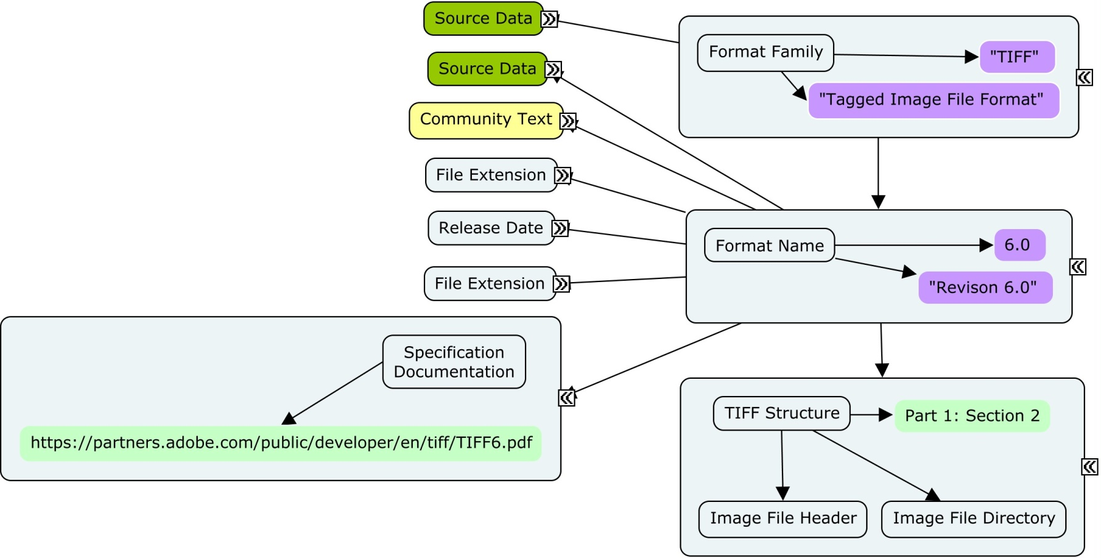
Step 2 – unpacking

Slide 32
unpacking to the “nth” layer
We simply keep doing this until:
  we reach a data primitive, which become properties of the parent aspect
  we decide that we don’t need to descend any further for our informational purposes, and stop at level we want to list
Notes:
Whats a primitive?

Slide 33
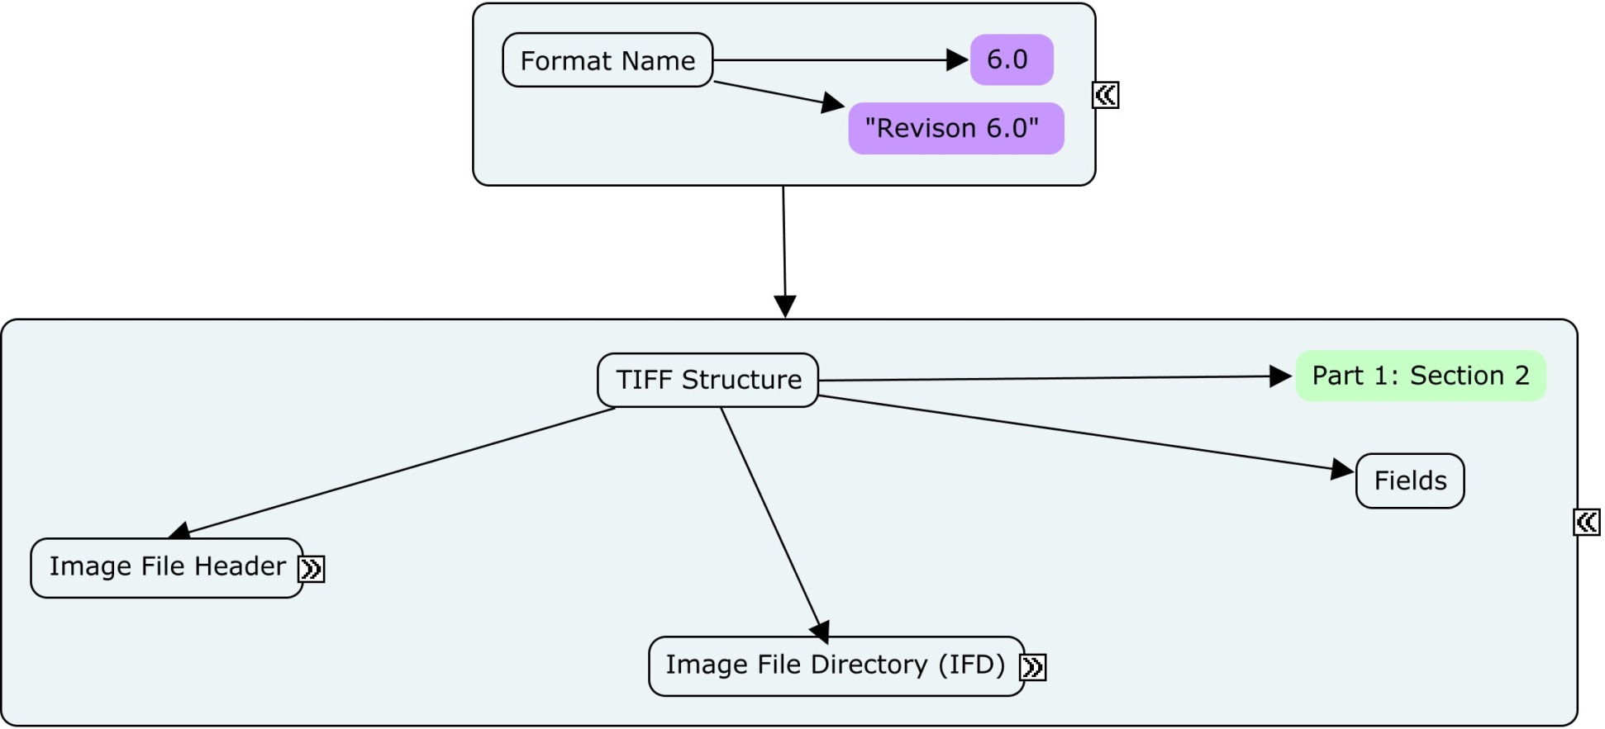

Slide 34
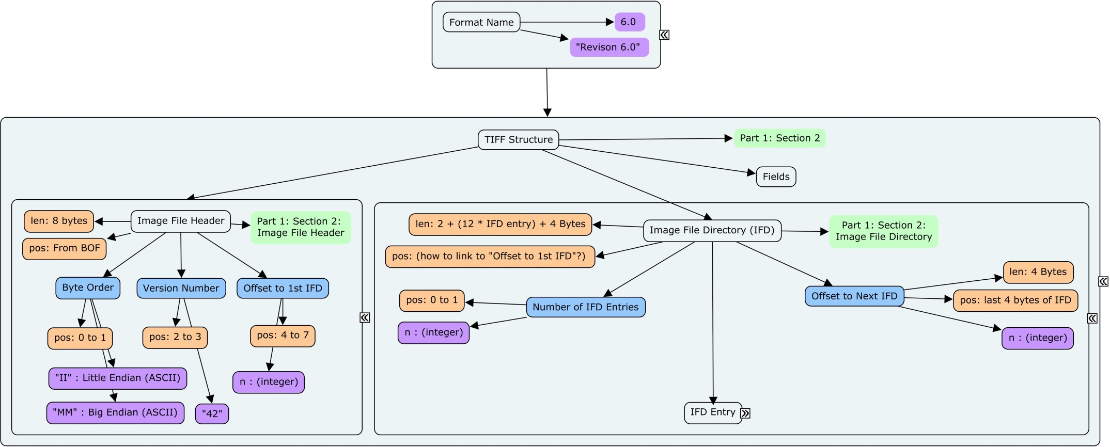

Slide 35
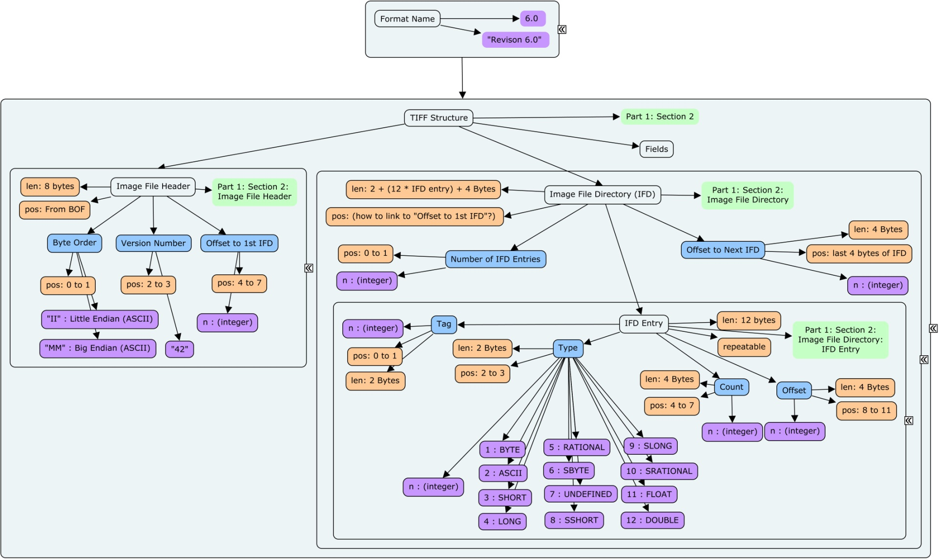

Slide 36
What has this bought us?
We can use the model to point to a specific part of a standard that we are interested in
We could use the “canonical” structural data to make a navigable structure and form for any described format
We have a very searchable, consistently presented model that we can use for research

Slide 37
What has this bought us?
We can provide conceptual descriptions for “things” once, and reuse those description where appropriate
We’re only doing the work we need to do to describe at the level of interest
Its easy for the model to be extended at a later date

Slide 38

Finishing off TIFF v6.0
What’s left in the standard to map out?
  Using the tag/field as a repeatable structure – how can we make use of standardised objects inside a format?

Slide 39
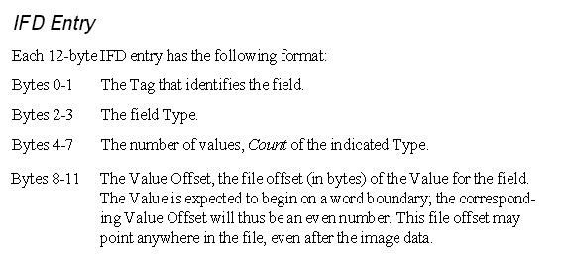
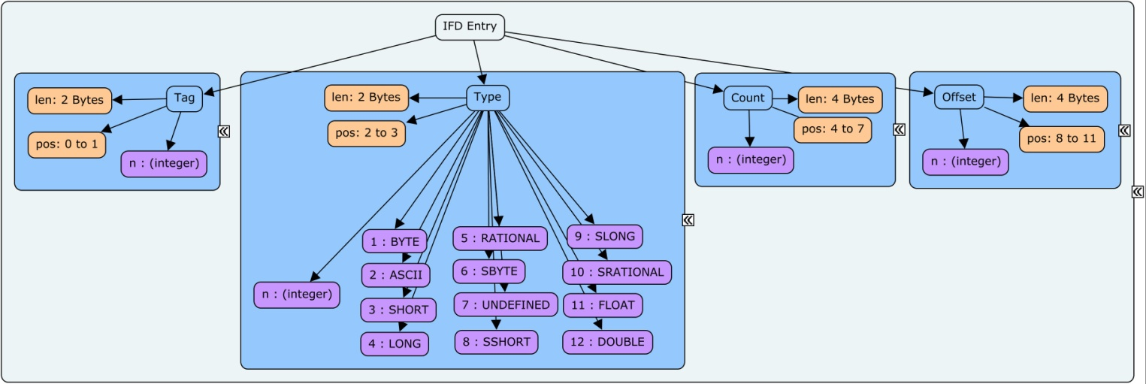
Lets look at a field/tag - structure
Structure is repeating, and well defined in the spec:-

Slide 40
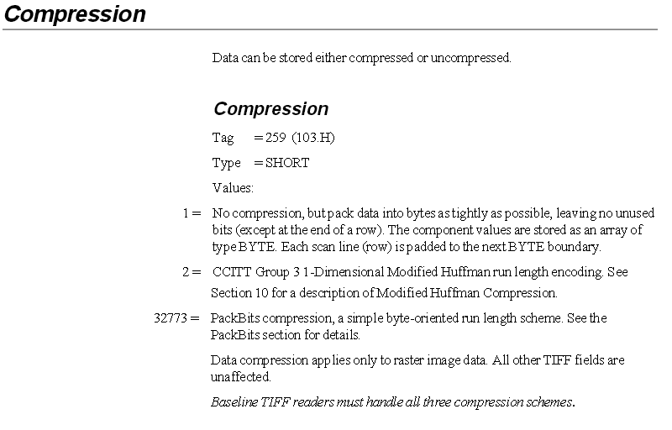
Lets look at a field/tag - example
This is taken from the baseline TIFF description
Notes:
Note the permitted values

Slide 41
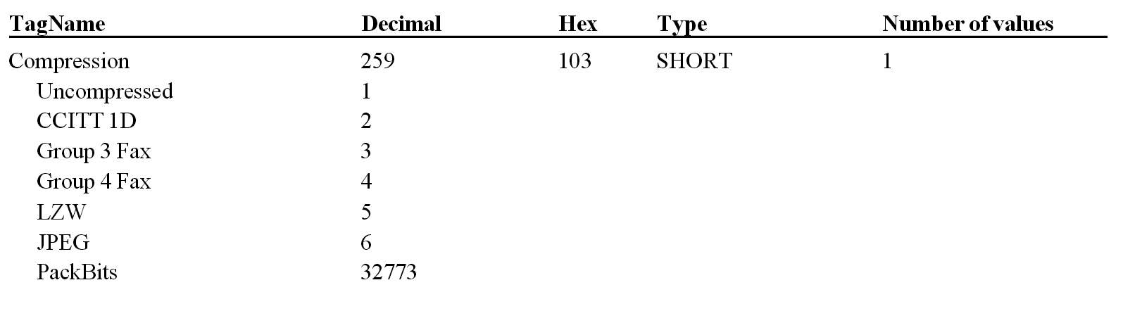
Lets look at a field/tag - example
This is taken from 6.0 Spec, Appendix A.

Slide 42
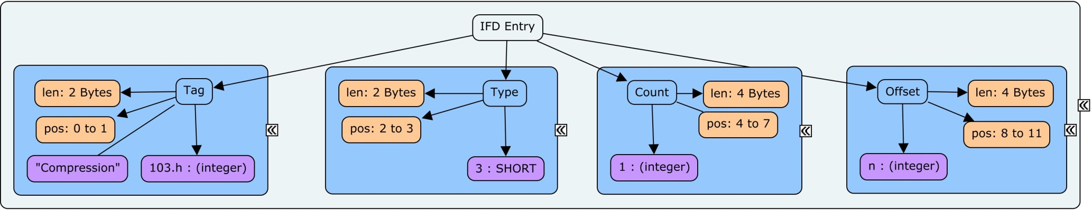
Lets look at a field/tag - example
We can use the structure we previously defined to describe this tag…
But we need to add a property that allows us to define permitted values

Slide 43
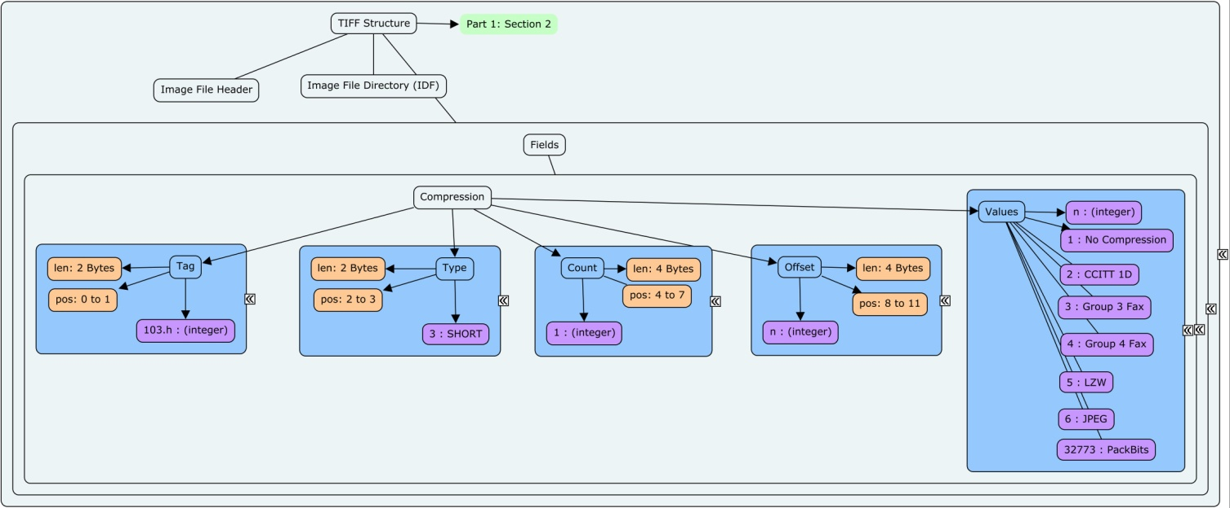
Lets look at a field/tag - example
Note the changes, as we populate a named tag into the fields aspect of the TIFF object:-

Slide 44
Remember Frodo?
Of course, compression is not a uniquely TIFF-esque feature. We find it in many digital formats in various guises and at various levels.
We will absolutely want to link these things together, using some suitable method.
This means we can start to search our format space for aspects that are common:-
‘Show me all formats that support compression, using LZW”

Slide 45
A quick sidebar – Values?
We have different concepts that need some attention when describing permissible values.
  A value. E.g. 1
  A list of items. E.g. “a”, “b”, “c” or “d”
  A range of values. E.g. 1.000 to 2.000
    Is it finite or continuous? (and what number of s.f.’s do you need?)
  A quantised range of values. E.g. 2 to 16000, in steps of 1
  A set of bit flags. E.g. 11001101.b where each bit is independent
What about default values?
  E.g. range = 5 to 15, default = 10
What about typing?
  E.g. integer, or integer(represented in hexadecimal) or string, or string(ASCII)

Slide 46
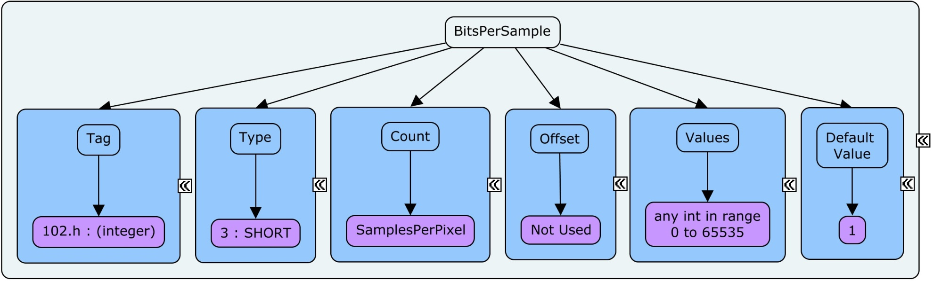
Some more examples of interest
Note the property called “Count” its value is actually the “Count” property value of another aspect called “SamplesPerPixel”
Note the permitted values parameters and the default value.

Slide 47
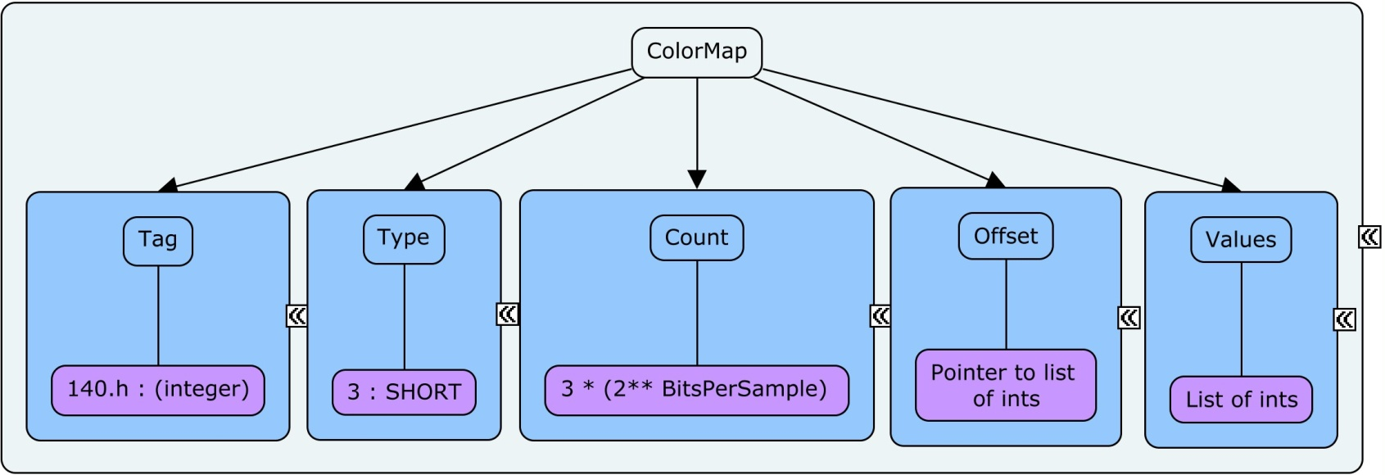
Some more examples of interest
Note the “Count” property. As previous, its value is derived via another aspect
We need to be able to link “BitsPerSample” to “ColorMap as they share a dependency

Slide 48
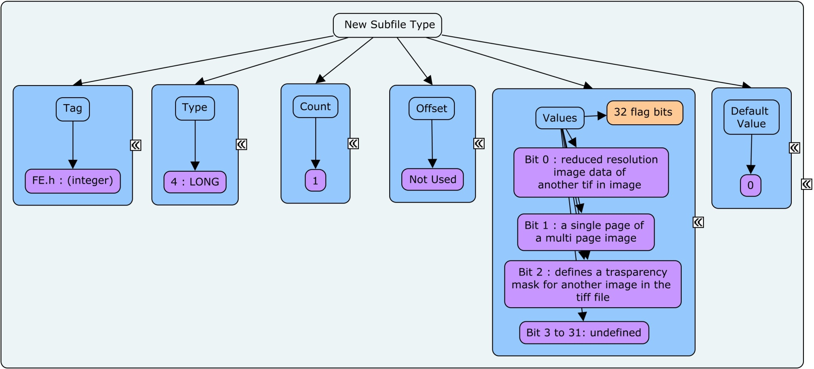
Some more examples of interest
Note the Values – bit flag type – actually quite complex
Is the default value correct? 0.d == 00000000 00000000 00000000 00000000.b
  Where is the LSB?

Slide 49
The Baseline concept in TIFF
TIFF revision 6.0 shares a concept with TIFF revision 5.0 called baseline tiff(6.0), or class X(5.0)
This defines the minimal set of descriptors for 4 different flavours of TIFF images
  Grayscale, palette color, RGB and bitonal
These are explicitly described in the specification
It would therefore be useful to extend the notion of TIFF format space to include this descriptive level

Slide 50
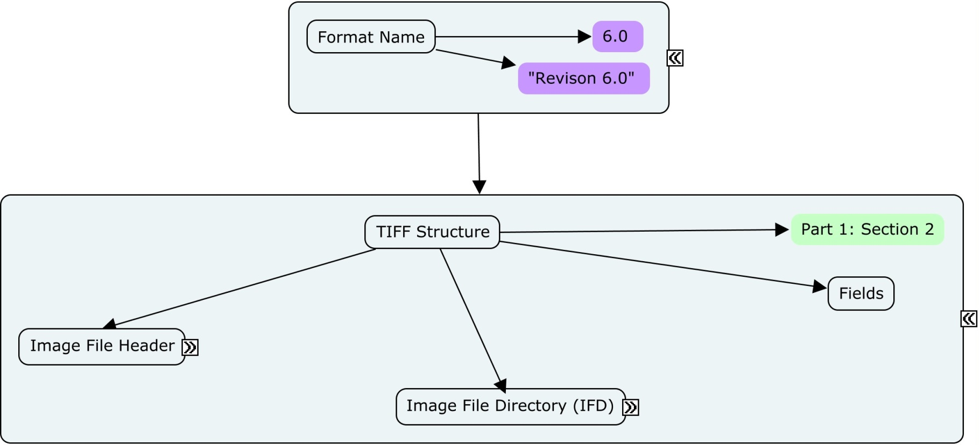
Conceptually – this:-

Slide 51
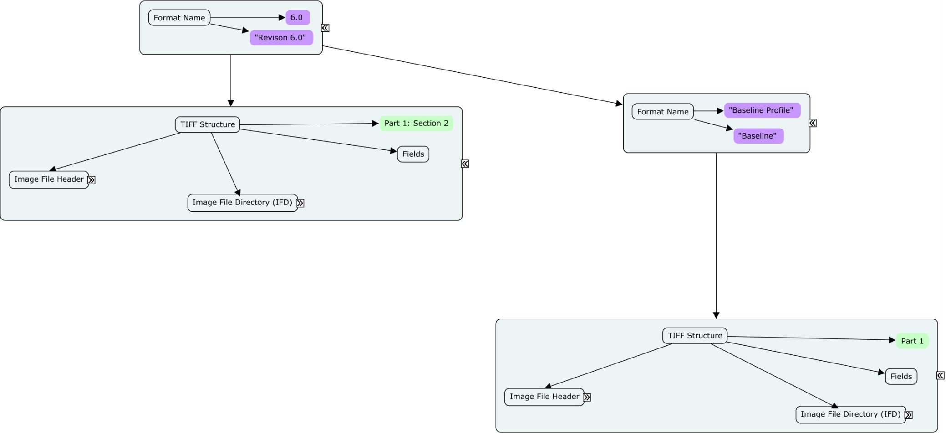
Becomes this:-
Of course, we need to manage this inheritance properly. The difference is really only in the “fields” entity.

Slide 52
And what is the difference?
The TIFF : Revision 6.0 specification describes the permitted tags to be a valid v6.0 file.
  This includes some 250 permitted tags
  This includes some extensions to values allowed in tags described in the baseline spec

Slide 53
And what is the difference?
The TIFF : Revision 6.0 : Baseline specification describes the permitted tags to be a valid baseline profiled file.
  This includes the 36 tags that relate to these properties
  This includes dependencies and relationships b/w tags

Slide 54
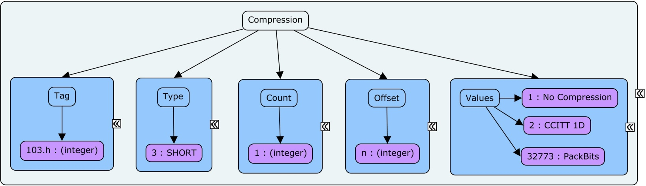
Lets look at one: Compression
TIFF : Revision 6.0 : Baseline : Structure : Fields : Compression

Slide 55
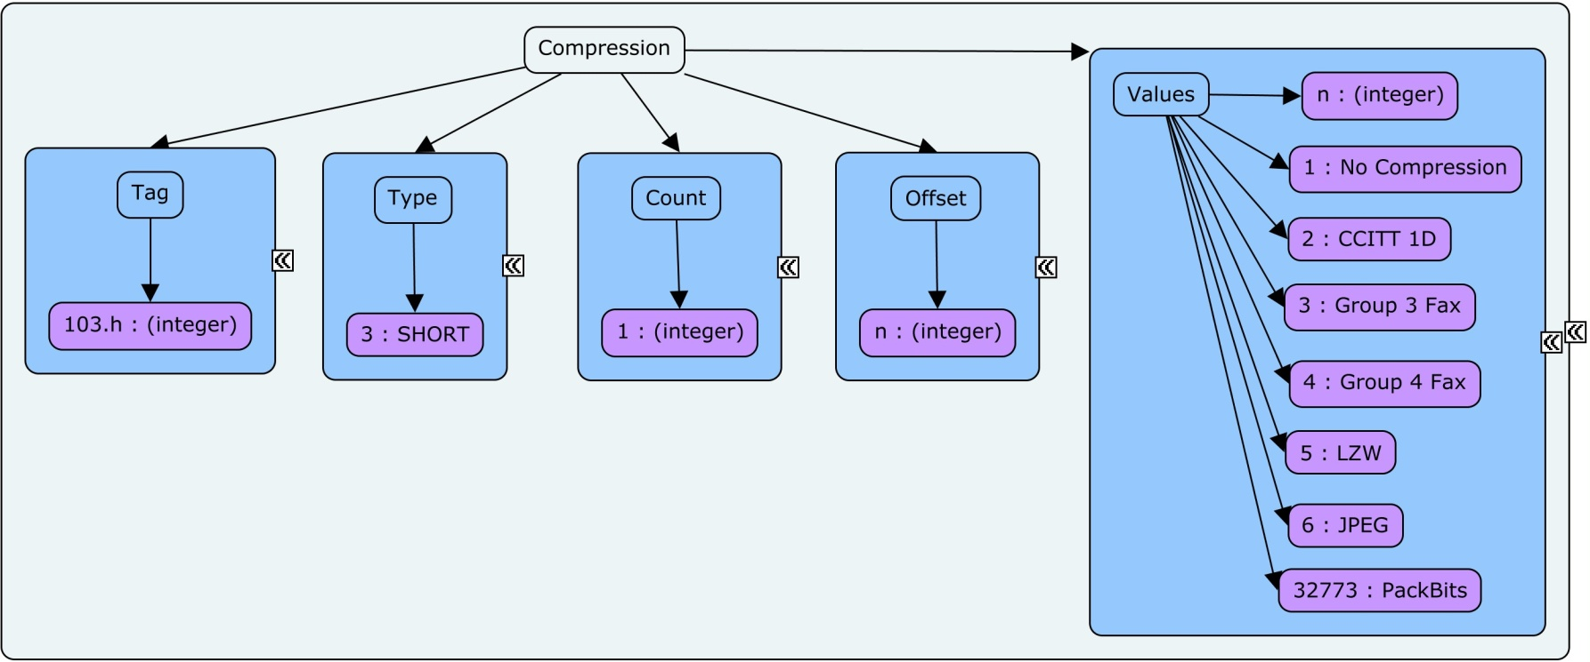
Lets look at one: Compression
TIFF : Revision 6.0 : Structure : Fields : Compression

Slide 56
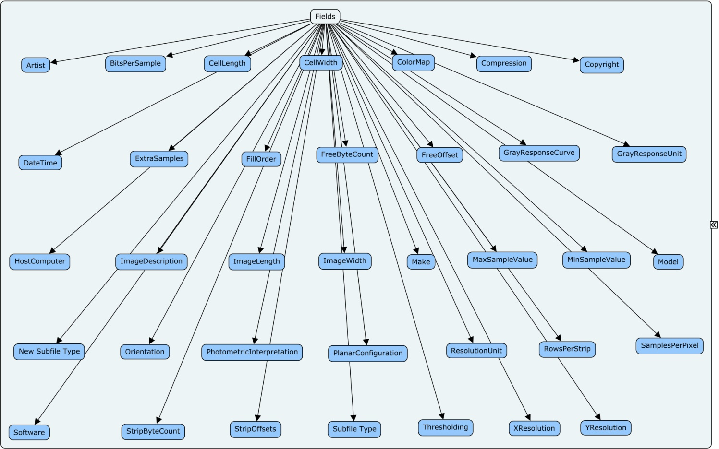
All the r6.0 : baseline fields:-
At this level, the tags are all set as properties of the field “aspect”
We could of course descend further, but this fulfils our task for now

Slide 57
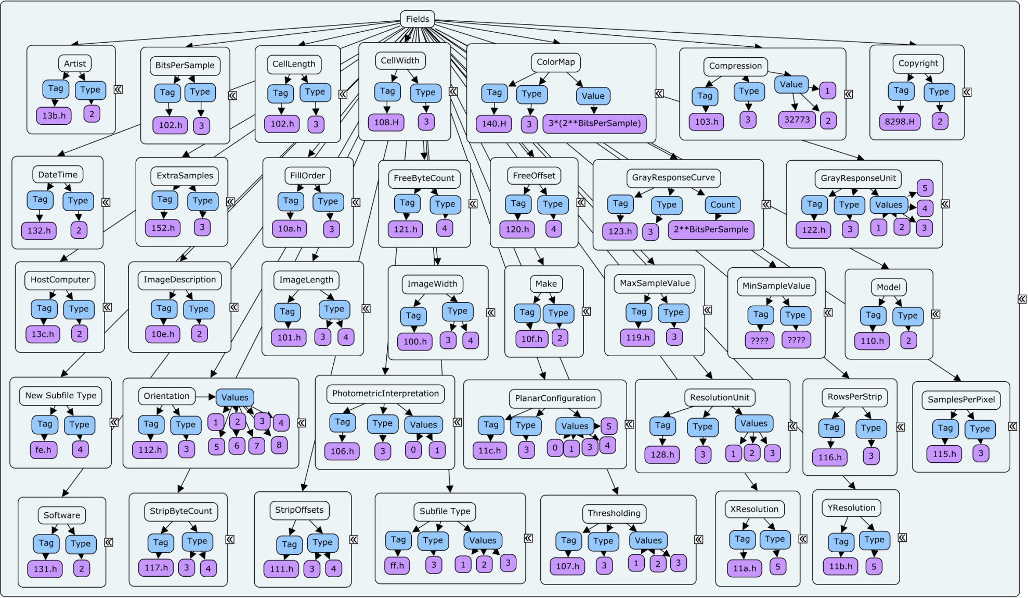
All the r6.0 : baseline fields:-

Slide 58
r6.0 : baseline
Lets take a look at a cmap model:-
Full Tif Baseline Spec

Slide 59
We don’t actually want stop at Baseline
Baseline contains 4 described variants, why not stop descend another level, and define the 4 types?
We also know that each of the types has some constraints on properties we expect to find for that level.
Lets get into these into a model for each named variant

Slide 60
Starting point is: r6.0 : baseline

Slide 61
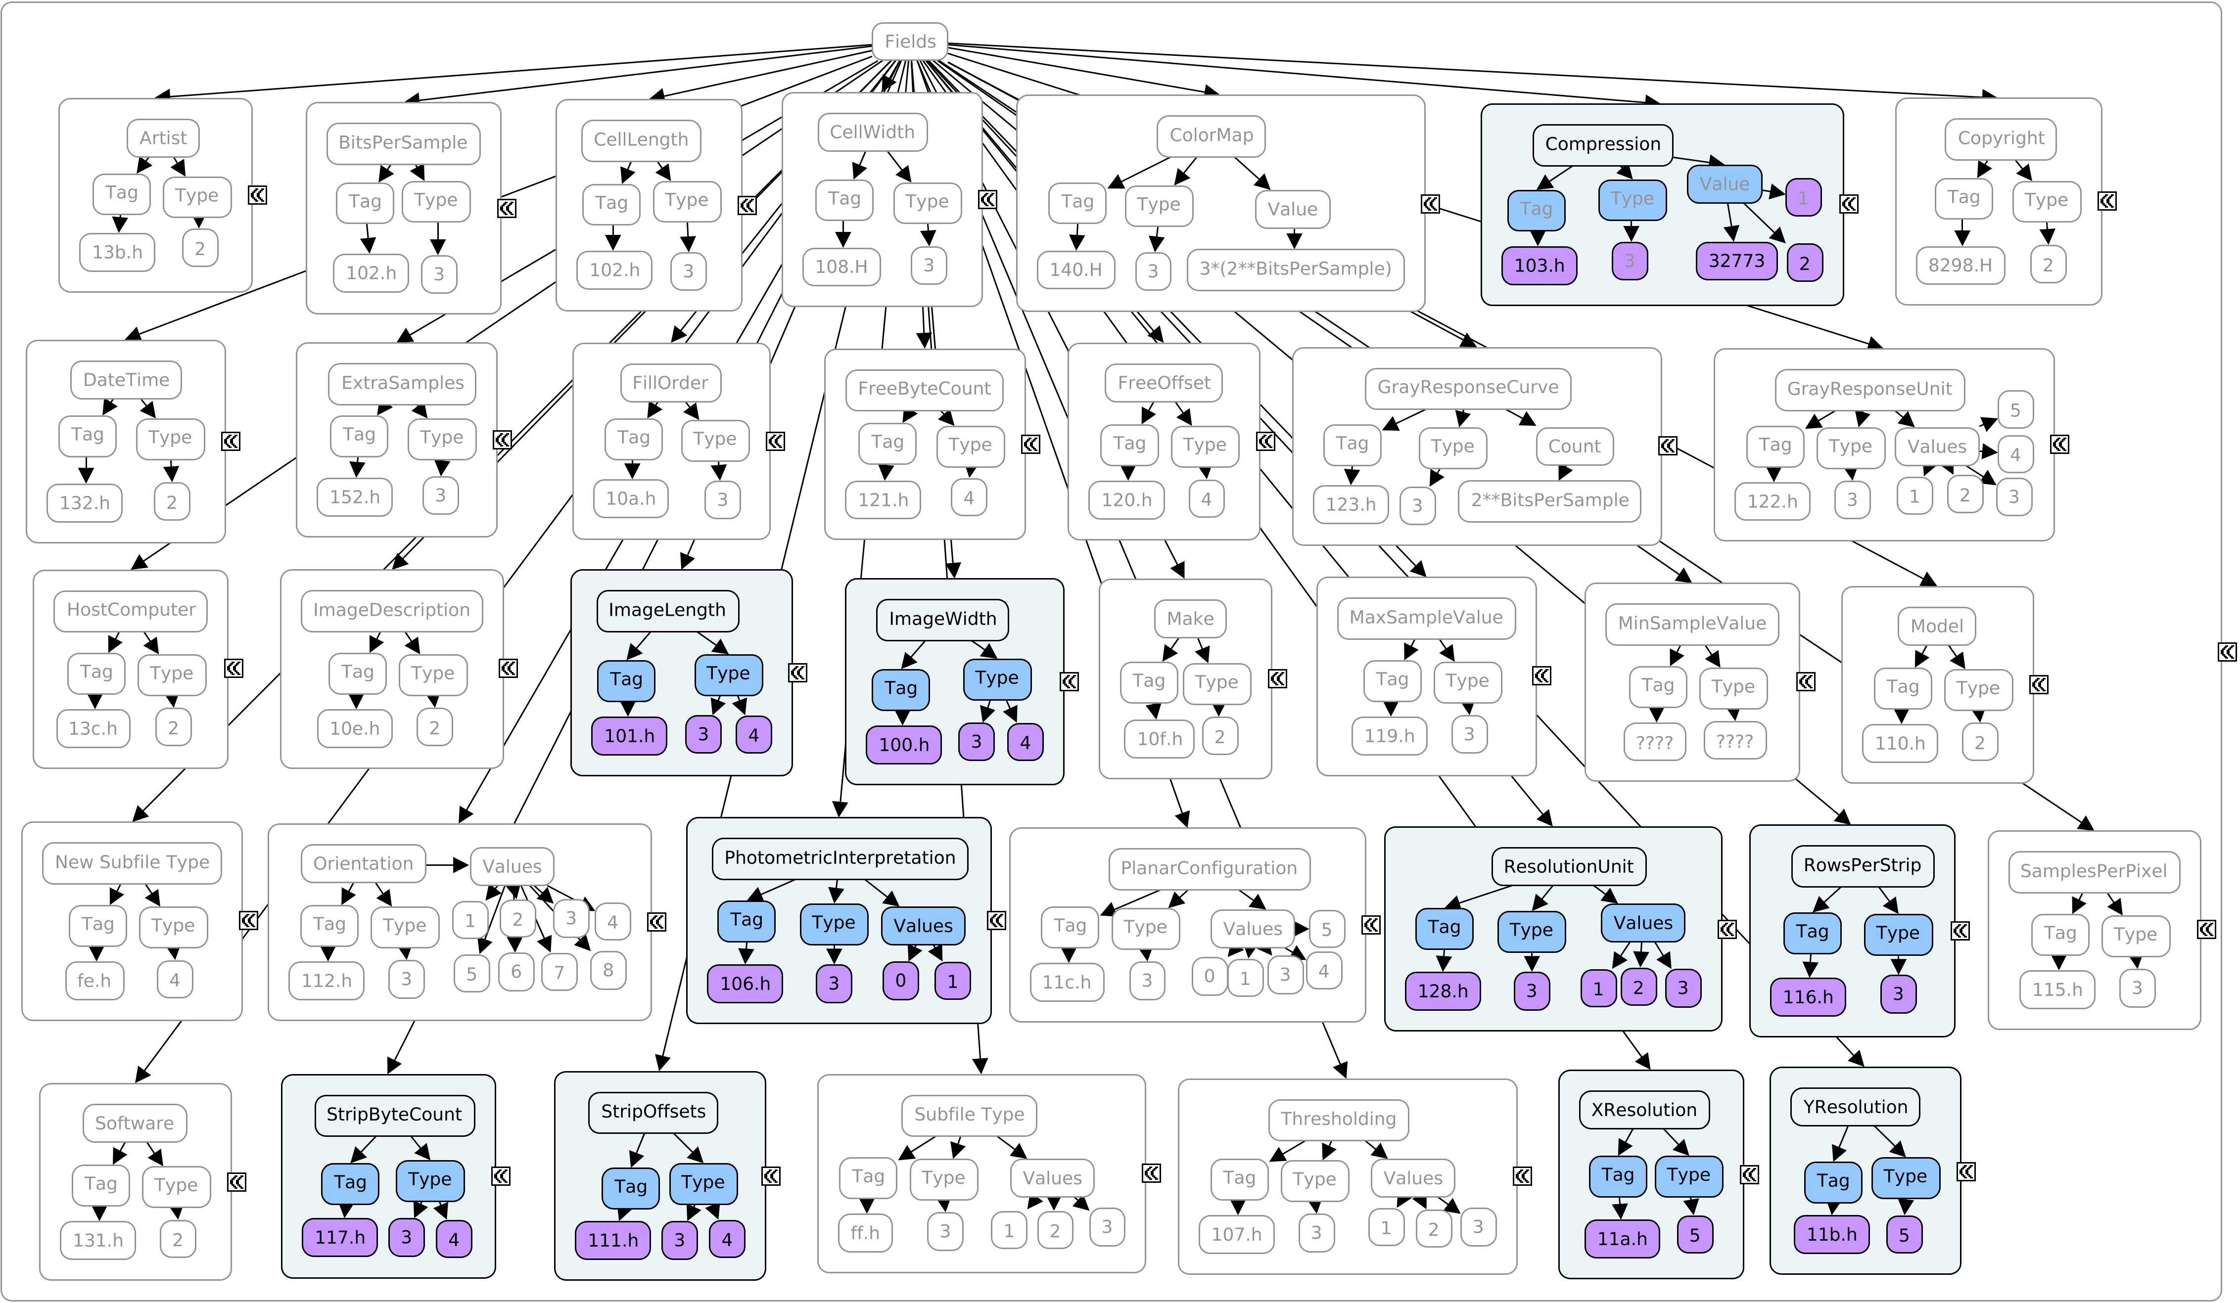
r6.0 : baseline : Bilevel images

Slide 62
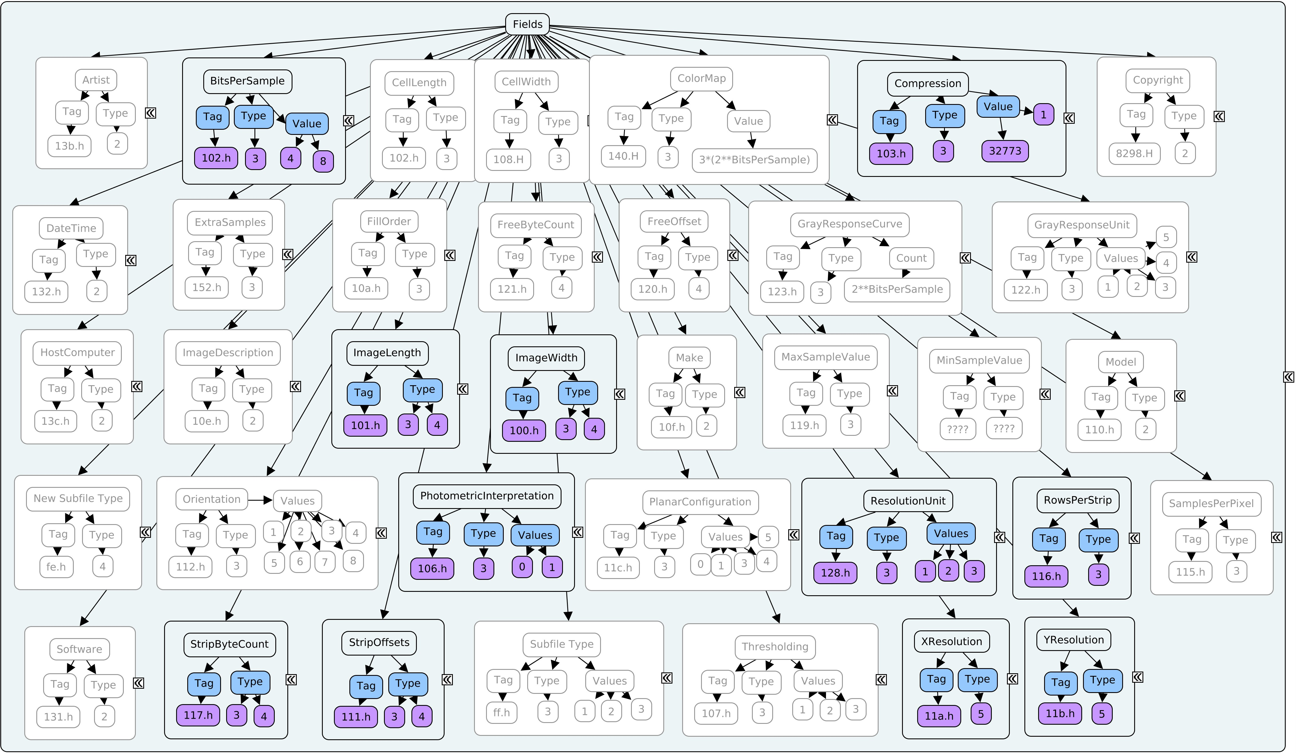
r6.0 : baseline : Grayscale images

Slide 63
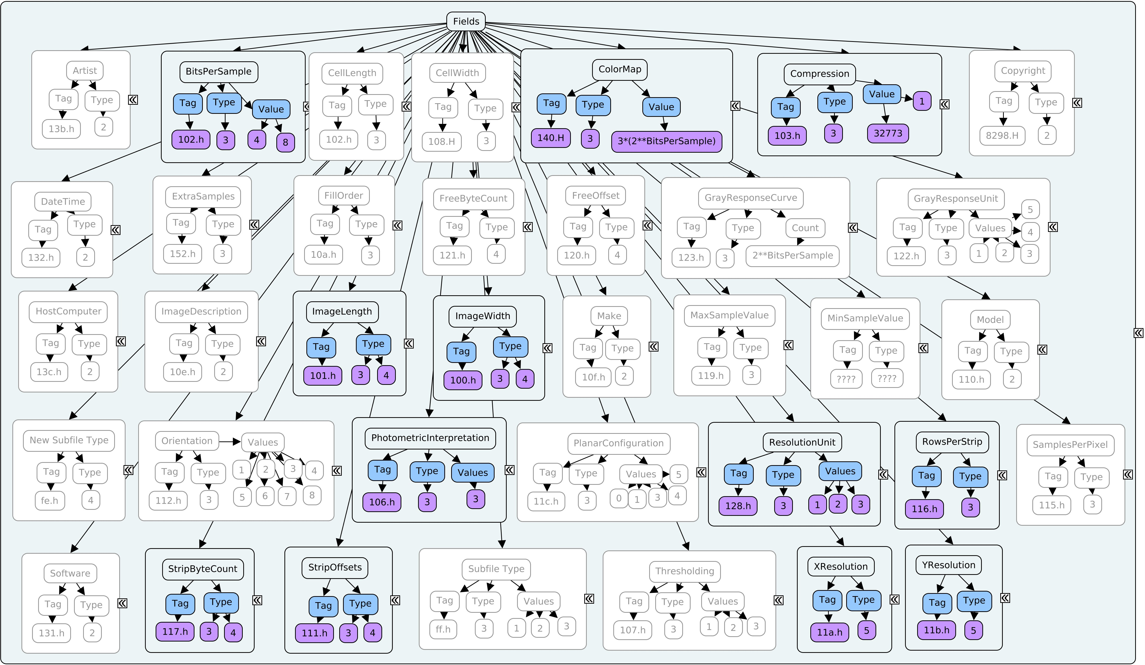
r6.0 : baseline : Palette Color

Slide 64
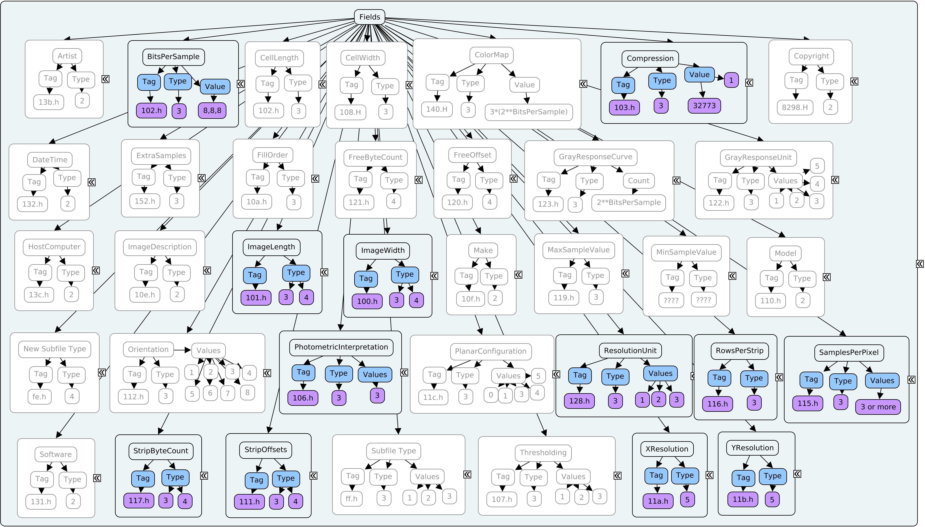
r6.0 : baseline : RGB full color

Slide 65
Lets think about the TIFF 6.0 space
Baselines
  RGB
  Palette
  Grayscale
  Bitonal
Other formal tags in the spec
The private space in tiff
Exif?

Slide 66
Lets abstract this away from TIFF model
Spec based formats (eg. RGB tags only)
Extended Spec based formats (RGB + other)
“Non Spec” based formats (RGB + described private tag)

Slide 67
Your turn…
Lets have a look at tiff 4.0. and see how we would start to populate a new format model
  Cmap
  Excel?
  Pen and paper!
  …
  As a group on the whiteboard

